Slide 1
PRESS RELEASE
GHANA, FEBRUARY 2025
PRODUCER PRICE INDEX AND INFLATION
19th March 2025

Slide 2
In this release, we present:
Definition and Measurement of the Producer Price Index (PPI)
Producer Price Index and Producer Inflation for February 2025
Disaggregation of the February 2025 Producer Inflation
Highlights of February 2025 Producer Inflation

Slide 3
Definition and Measurement of PPI and Inflation (1/2)
The Producer Price Index (PPI) measures the average change over time in the selling prices of goods and services as received by domestic producers.
Prices collected for the computation of PPI are known as factory gate price, which are the prices firms assign to their products.
These prices exclude sales and excise taxes, government subsidies other costs incurred by other intermediaries and consumers
The rate of Producer Inflation is the relative change in PPI between periods

Slide 4
Definition and Measurement of PPI and Inflation (2/2)
PPI computation is based on a fixed basket of products.
Firms are the primary source of data
Firms are selected based on the Integrated Business Establishment Survey
Variables for the computation of PPI are weights, prices, quantities of products.
Two reference periods for the computation of PPI are the weight reference (industry and product shares) and the index reference for price comparison.
The computation is done from a dual time perspective, monthly and annually

Slide 5
Reference Periods - PPI and Inflation
Weight Reference-2019
Weight reference at the industry level is based on 2019 Gross Value Output (GVO)
Selection of firms is based on the 2013 Integrated Business Establishment Survey (II)
Index Reference (Price Comparison)– March 2020 to February 2021 =100

Slide 6
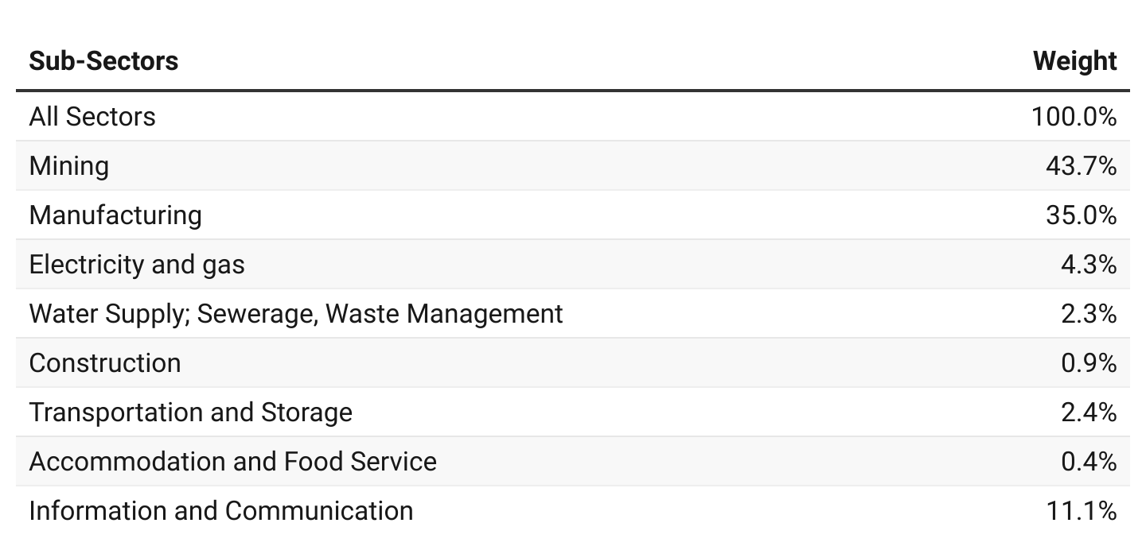
PPI Weights

Slide 7
Producer Price Index and Producer Inflation for February 2025
PPI for February 2025 was 274.4 relative to 215.0 for February 2024
Year-on-year inflation rate at ex-factory prices for all goods and services was 27.6 percent in February 2025.
Month-on-month producer inflation between January 2025 and February 2025 was 1.5 percent.

Slide 8
Disaggregation of the YoY January 2025 and February 2025 Producer Inflation by Sectors

Slide 9
Disaggregation of the February 2025 Producer Inflation by Sub-Sectors

Slide 10
Inflation of Sub-groups within the Construction Sub-Sector for February 2025
PPI release
Feb. 2025

Slide 11
Inflation of Sub-groups within the Mining and Quarrying Sub-Sector for February 2025

Slide 12
Sub-groups within the Manufacturing sub-sector with inflation rates above the sub-sector rate for February 2025

Slide 13
Producer Inflation for Services Sub-Sector for February 2025

Slide 14
Highlights for February 2025 YoY Inflation
42.9%
Industry
44.6%
Mining and quarrying
4.9%
Water supply, sewerage and waste management
28.5%
Year-on-year
Producer Inflation
January 2025
20.8%
Manufacturing
27.6%
Year-on-year Producer Inflation
February 2025
7.7%
Service
26.5%
Accommodation and food
9.7%
Electricity and gas
22.7%
Transport and storage
15.8%
Construction
4.2%
Information and communication

Slide 15
Highlights for February 2025 MoM Inflation
2.1 %
Industry
0.0%
Water supply, sewerage and waste management
3.6%
Month-on-month
producer inflation
January 2025
2.0%
Mining and quarrying
1.5 %
Month-on-month
Producer Inflation
February 2025
1.3%
Manufacturing
0.6%
Services
0.7%
Electricity and gas
2.6%
Transport and storage
1.7%
Accommodation and food
1.0%
Construction
0.1%
Information and communication

Slide 16
THANK YOU End of Press Release for February 2025 Producer Price Index For enquiries, please contact: Dr. Anthony Krakah (Head, Business & Industrial Statistics, GSS) anthony.krakah@statsghana.gov.gh

