Slide 1
CONSUMER PRICE INDEX AND INFLATION
PRESS RELEASE
12th May, 2021

Slide 2
In this release, we present:
Definition and Measurement of Consumer Price Index (CPI) and Rate of Inflation
CPI and Rate of Inflation for April 2021
Dominant Divisions of Rate of Inflation for April 2021
Disaggregation of Rate of Inflation for April 2021
Highlights of CPI and Rate of Inflation for April 2021

Slide 3
Definition and measurement of CPI and rate of inflation (1/3)
CPI measures changes in the price of a fixed basket of goods and services purchased by households
The assumption is that the basket is purchased each month, hence as price changes each month, the total price of the basket will also change
The rate of inflation is the relative change in CPI between periods
Inflation is reported year-on-year (annual inflation) and month-on-month (monthly inflation), and granulated to determine regional and commodity type and source of inflation
2

Slide 4
Definition and measurement of CPI and rate of inflation (2/3)
CPI does not measure price levels
CPI is a price perspective measure and cost-of-living index is an expenditure oriented measure
Data (market readings) are captured monthly
Key variables are prices, quantities and expenditure weights of items
Price reference year is 2018 (2018 = 100)
3

Slide 5
Definition and measurement of CPI and rate of inflation (3/3)
Prices are collected for approximately 39,500 products every month.
Price collection is done in 44 markets
Prices are collected from 7,726 outlets.
Products are ordered in a hierarchy of 13 Divisions, 44 Groups, 98 Classes, 156 Subclasses and 307 Items.
Every Item can only be part of one Subclass, and every Subclass can only be part of one Class, etc.
4

Slide 6
CPI and inflation for April 2021
Month | CPI | Inflation
 |  | Monthly | Yearly | averages
Apr-2020 | 116.6 | 3.2% | 10.6% | Q2: 11.0%
May-2020 | 118.6 | 1.7% | 11.3%
June-2020 | 119.8 | 1.0% | 11.2%
July-2020 | 120.5 | 0.5% | 11.4% | Q3: 10.8%
Aug - 2020 | 120.0 | -0.4% | 10.5%
Sep – 2020 | 119.8 | -0.2% | 10.4%
Oct- 2020 | 120.1 | 0.2% | 10.1.% | Q4: 10.1%
Nov-2020 | 120.4 | 0.3% | 9.8%
Dec-2020 | 121.5 | 0.9% | 10.4%
Jan-2021 | 122.7 | 0.9% | 9.9%
Feb-2021 | 123.6 | 0.8% | 10.3% | Q1: 10.2
Mar-2021 | 124.7 | 0.9% | 10.3%
Apr-2021 | 126.6 | 1.5% | 8.5%
CPI for April 2021 is 126.6 relative to 116.6 in April 2020
Year-on-year inflation rate for April 2021 was 8.5%
This means that in the month of April 2021 the general price level was 8.5% higher than in April 2020
Month-on-month inflation between March 2021 and April 2021 was 1.5%
5

Slide 7
Disaggregation of April 2021 rate of inflation
Food inflation was 6.5%
Last month this was 10.8%
Average over last 12 month was 12.8%
Month-on-month Food inflation was 2.3%.
Non-food Inflation was 10.2%
Last month this was 10.0 %
Month-on-month Non-Food inflation was 1.0%
Inflation for locally produced items was 8.7%
Inflation for imported items was 7.4%
6

Slide 8
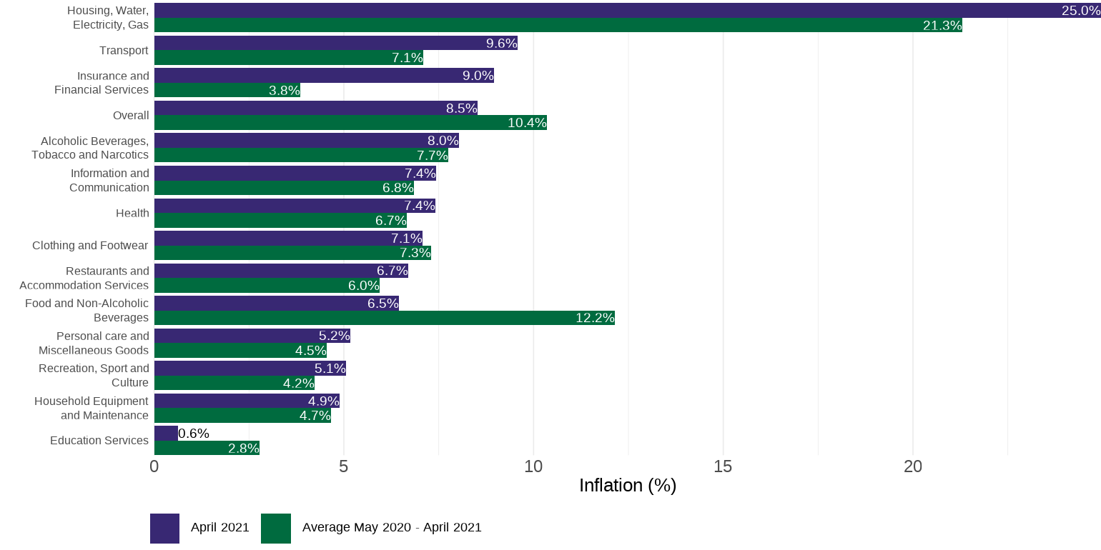
Disaggregation of year-on-year inflation by Division
7

Slide 9
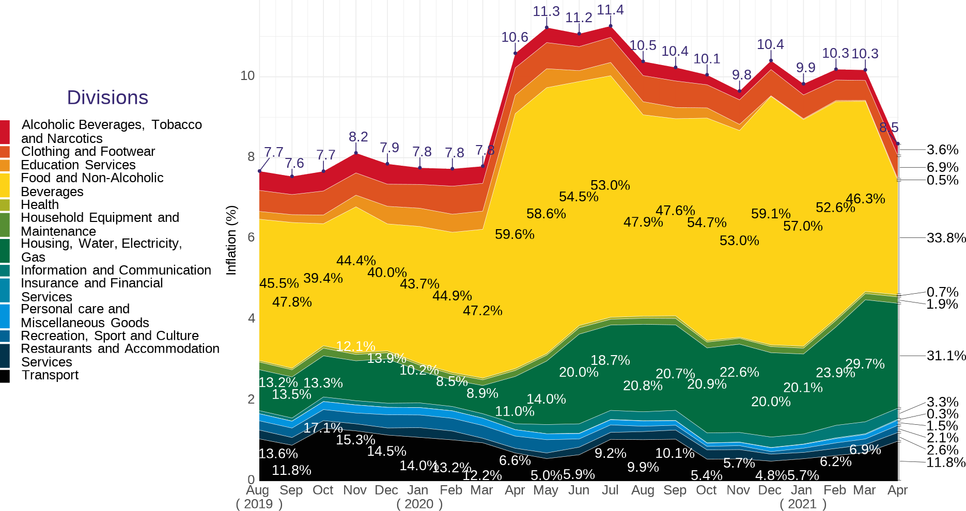
Composition of year-on-year inflation
Food contributed 33.8% to overall inflation.
This is the lowest since the rebase in 2018
8
Notes:
For the

Slide 10
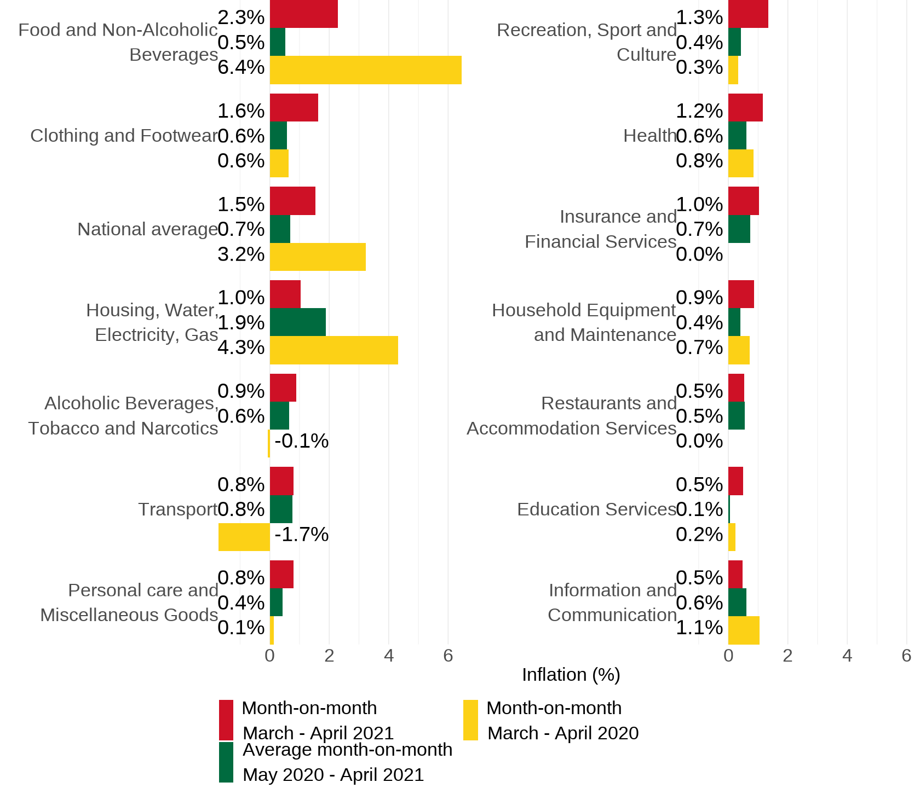
Disaggregation of
month-on-month inflation
Food recorded a month-on-month 2.3%
This is higher than last month (0.2%)
An indication that food items are expensive today than last month

Slide 11
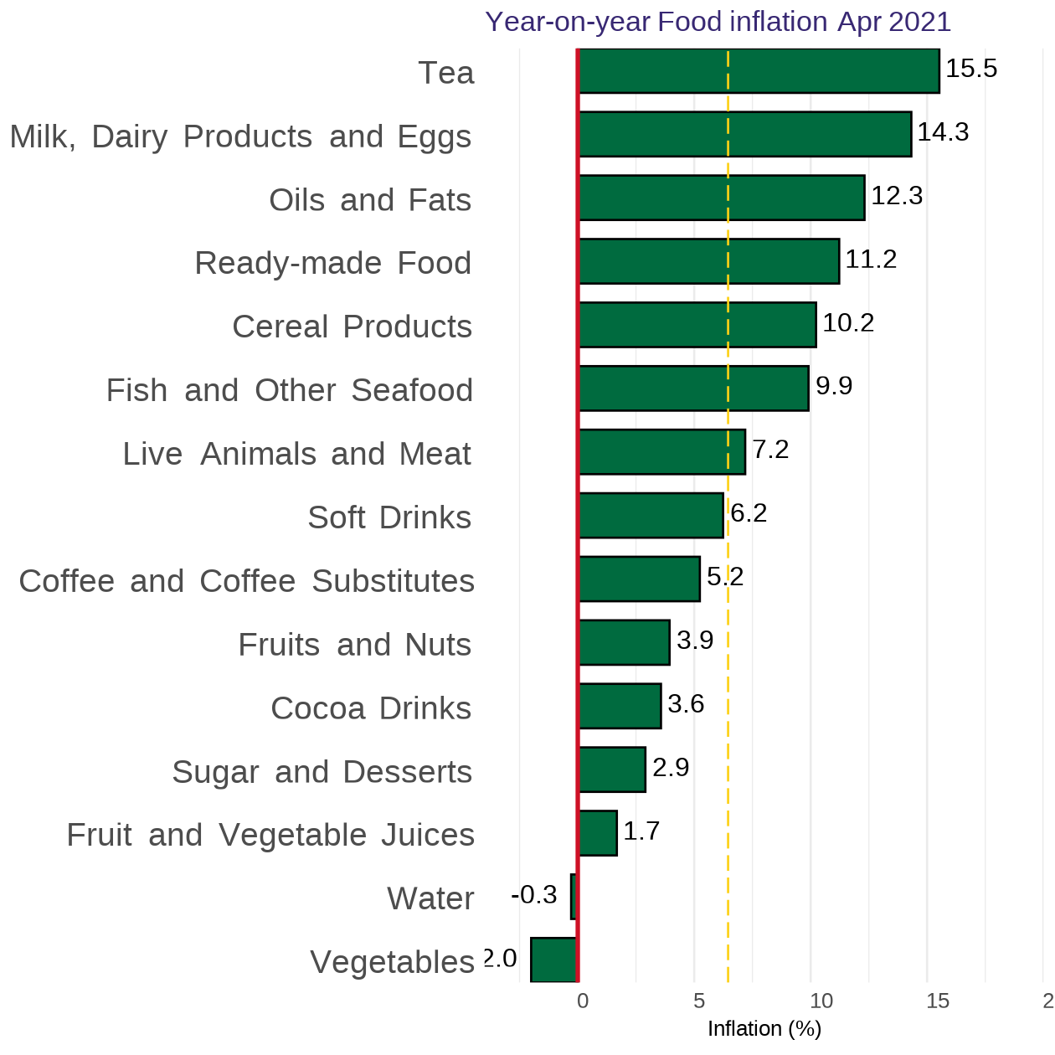
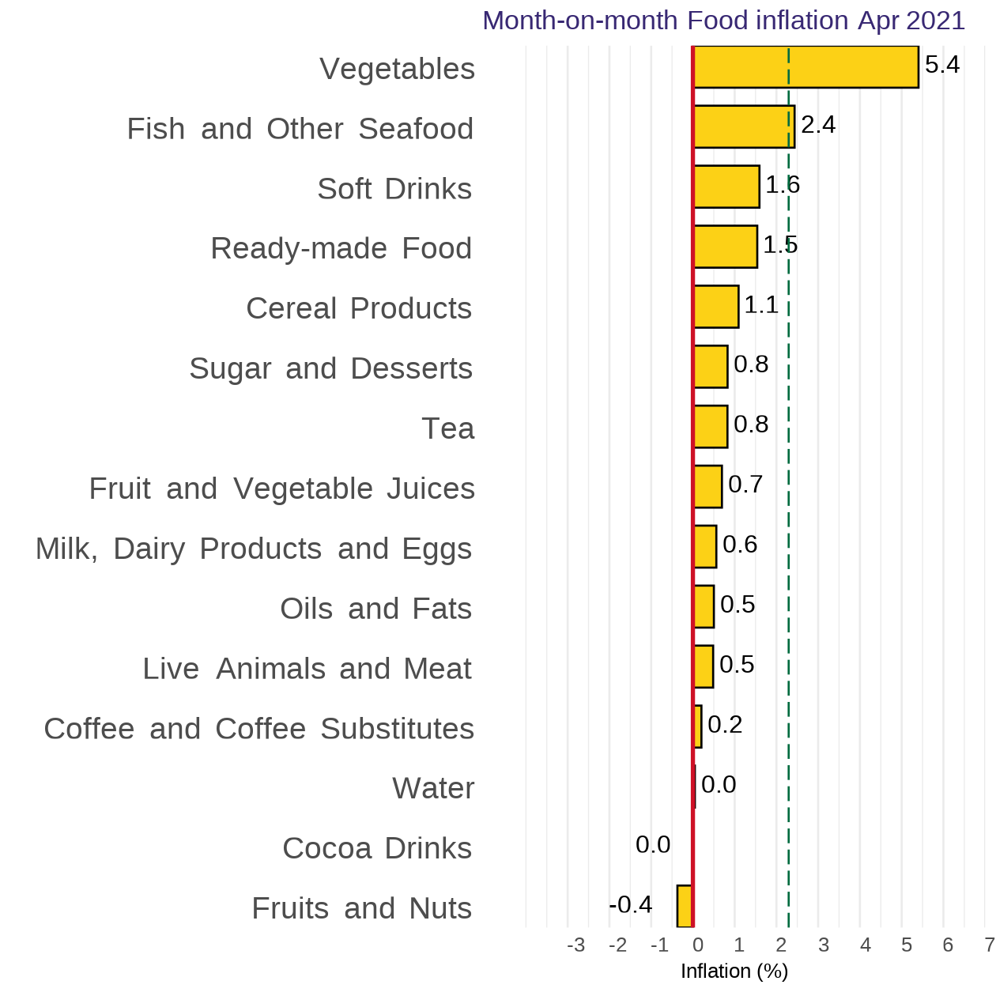
Disaggregation of YoY and MoM Food-inflation by Subclass
10

Slide 12
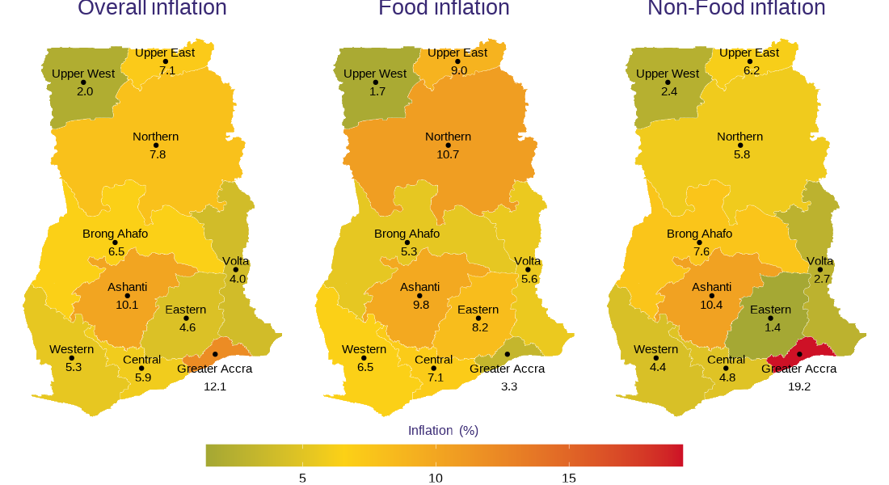
April 2021 regional rates of inflation
11

Slide 13
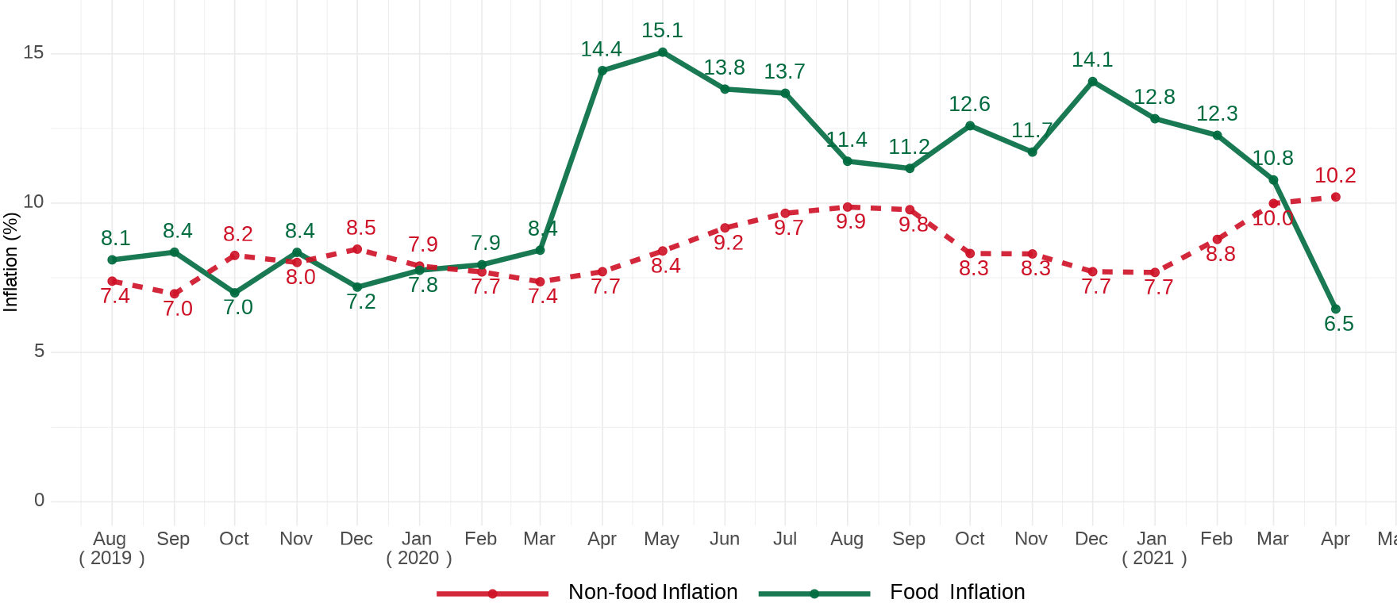
Food and Non-Food year-on-year inflation Aug. 19 – Apr. 21

Slide 14
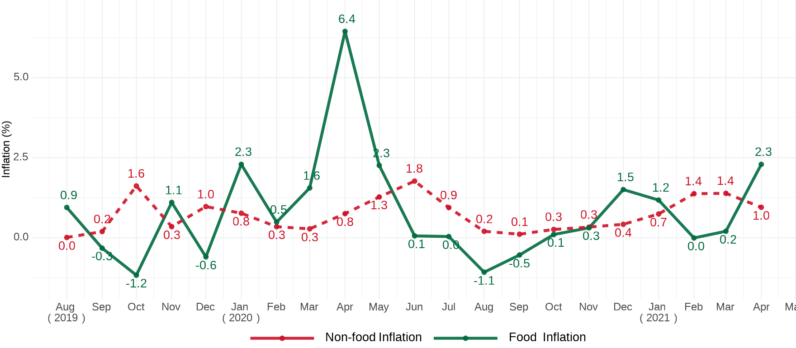
Food & Non-Food month-on-month inflation Aug. 2019–Apr. 2021
Notes:
In general, Non-food inflation seems less volatile compared to food inflation.

Slide 15
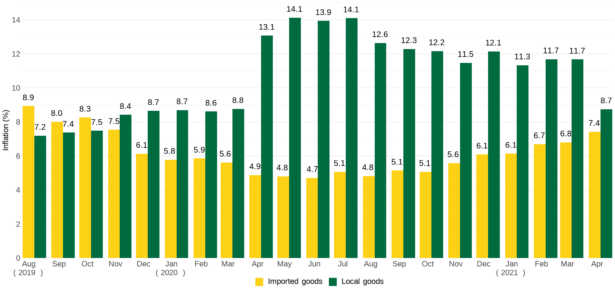
Imported and local inflation August 2019 – April 2021

Slide 16
Disaggregation of inflation in Greater Accra for April. 2021
15

Slide 17
Highlights
Year-on-year inflation for April 2020 – April 2021 was 8.5%.
Month-on-month (March 2021 - April 2021) inflation was 1.5%.
Year-on-year variation between food (6.5%) and non-food inflation (10.2%) was 3.7%.
Month-0n-month food inflation exceeds non-food inflation by 1.3 percentage points (2.3% vs. 1.0%)
Ten out of the 13 divisions on both Y-o-Y and M-o-M basis record higher inflation relative to the 12-month rolling average and same period last year
Housing, Water, Electricity and Gas especially in Greater Accra shows significant changes both on a Y-o-Y and M-o-M basis for April 2021
Difference between locally produced items (8.7%) and imported items (7.4%) reduces further to 1.3%.
Year-on-year food inflation in Northern region surpasses Greater Accra region by 7.4 percentage points (10.7% vs. 3.3% respectively.
16

Slide 18
End of Press Release for April 2021 Consumer Price Index
For enquiries, please contact:
https://statsghana.gov.gh/gssmain/fileUpload/Price%20Indices/CPI_Technical_Guide_v5_Published_14102020.pdf
Mr. John F.K. Agyaho
(Head, Price Statistics, GSS)
john.agyaho@statsghana.gov.gh

Slide 19
Consumer Price Index and Inflation
April 2021

